Slide 1
How Poor Countries Can Catch Up: Flying Geese and Leading Dragons
Justin Yifu, Lin

Slide 2
The mystery of the great divergence
The indication of neo-classic development model: developing countries will catch up (steady state)
However, the truth is between 1950 and 2008 only 28 economies reduced their per capita income gap with the United States
What really explains economic development?

Slide 3
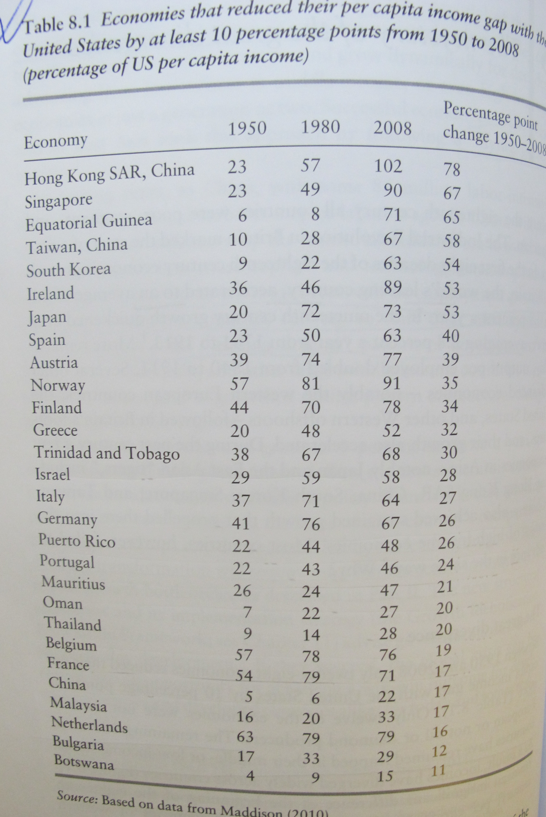

Slide 4
Structural upgrade
“Economic development is a process of continuing industrial and technological upgrading in which any country, regardless of its level of development, can succeed if it develops industries consistent with its comparative advantage, as determined by its endowment structure.”
“The secret to a winning performance is for developing countries to exploit the latecomer advantage by building up industries that are growing dynamically in more advanced countries with endowment structure similar to theirs.”

Slide 5
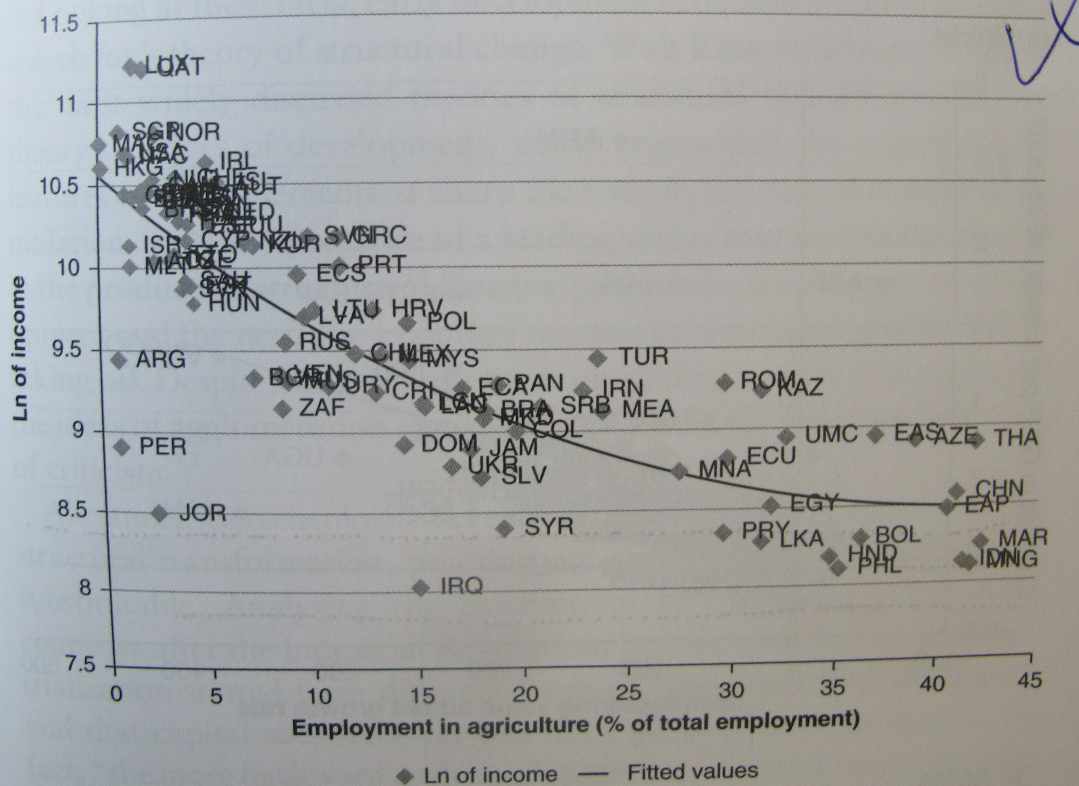

Slide 6
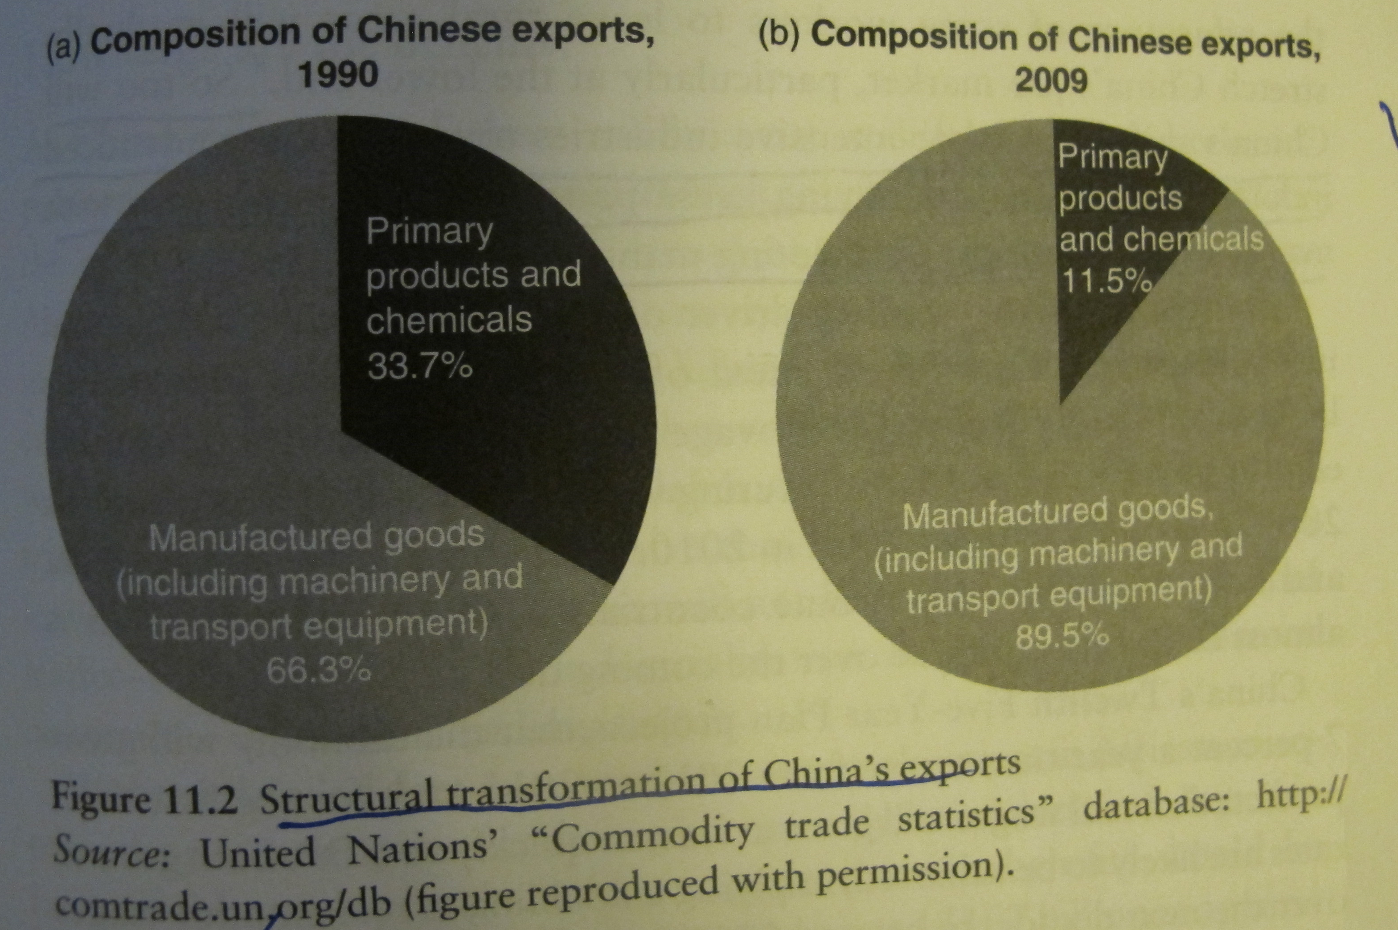

Slide 7
Flying Geese in the late 20th century
An International perspective
Efficient Sequence of development

Slide 8
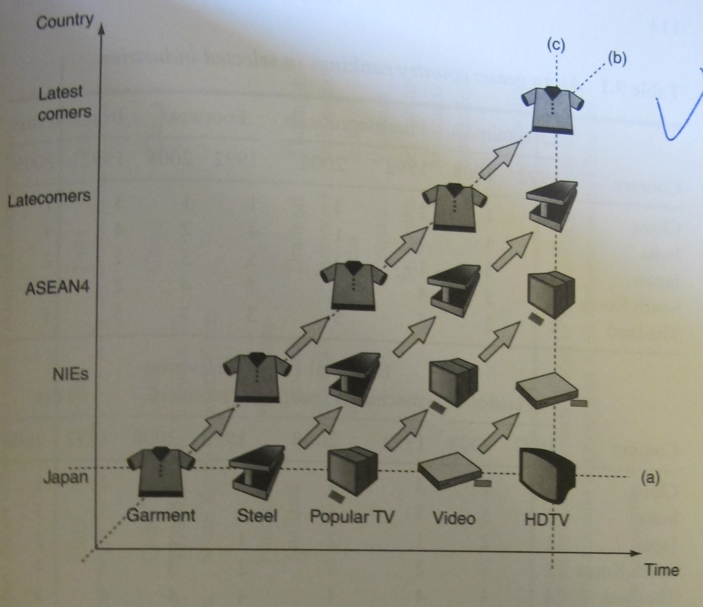

Slide 9
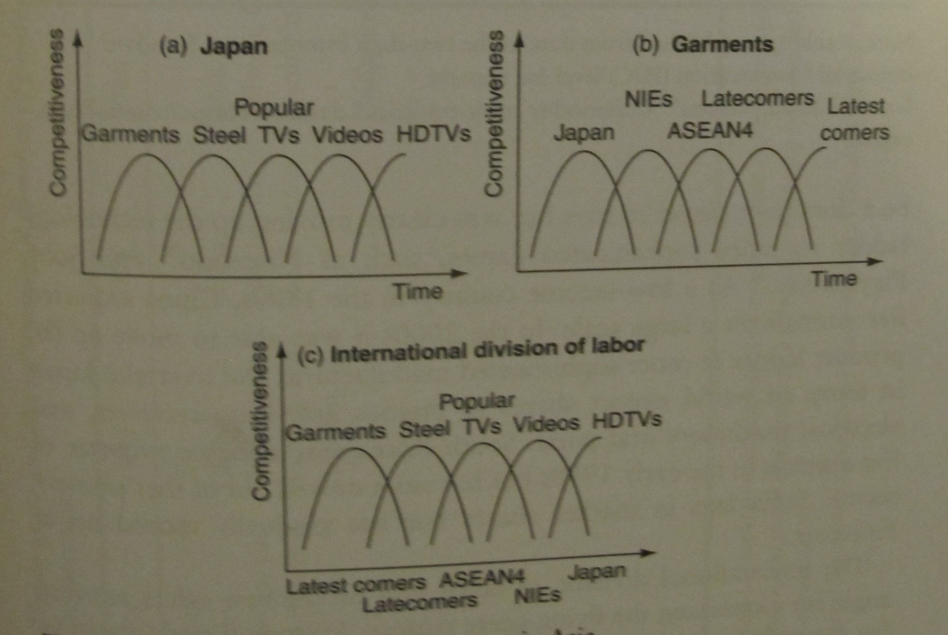

Slide 10
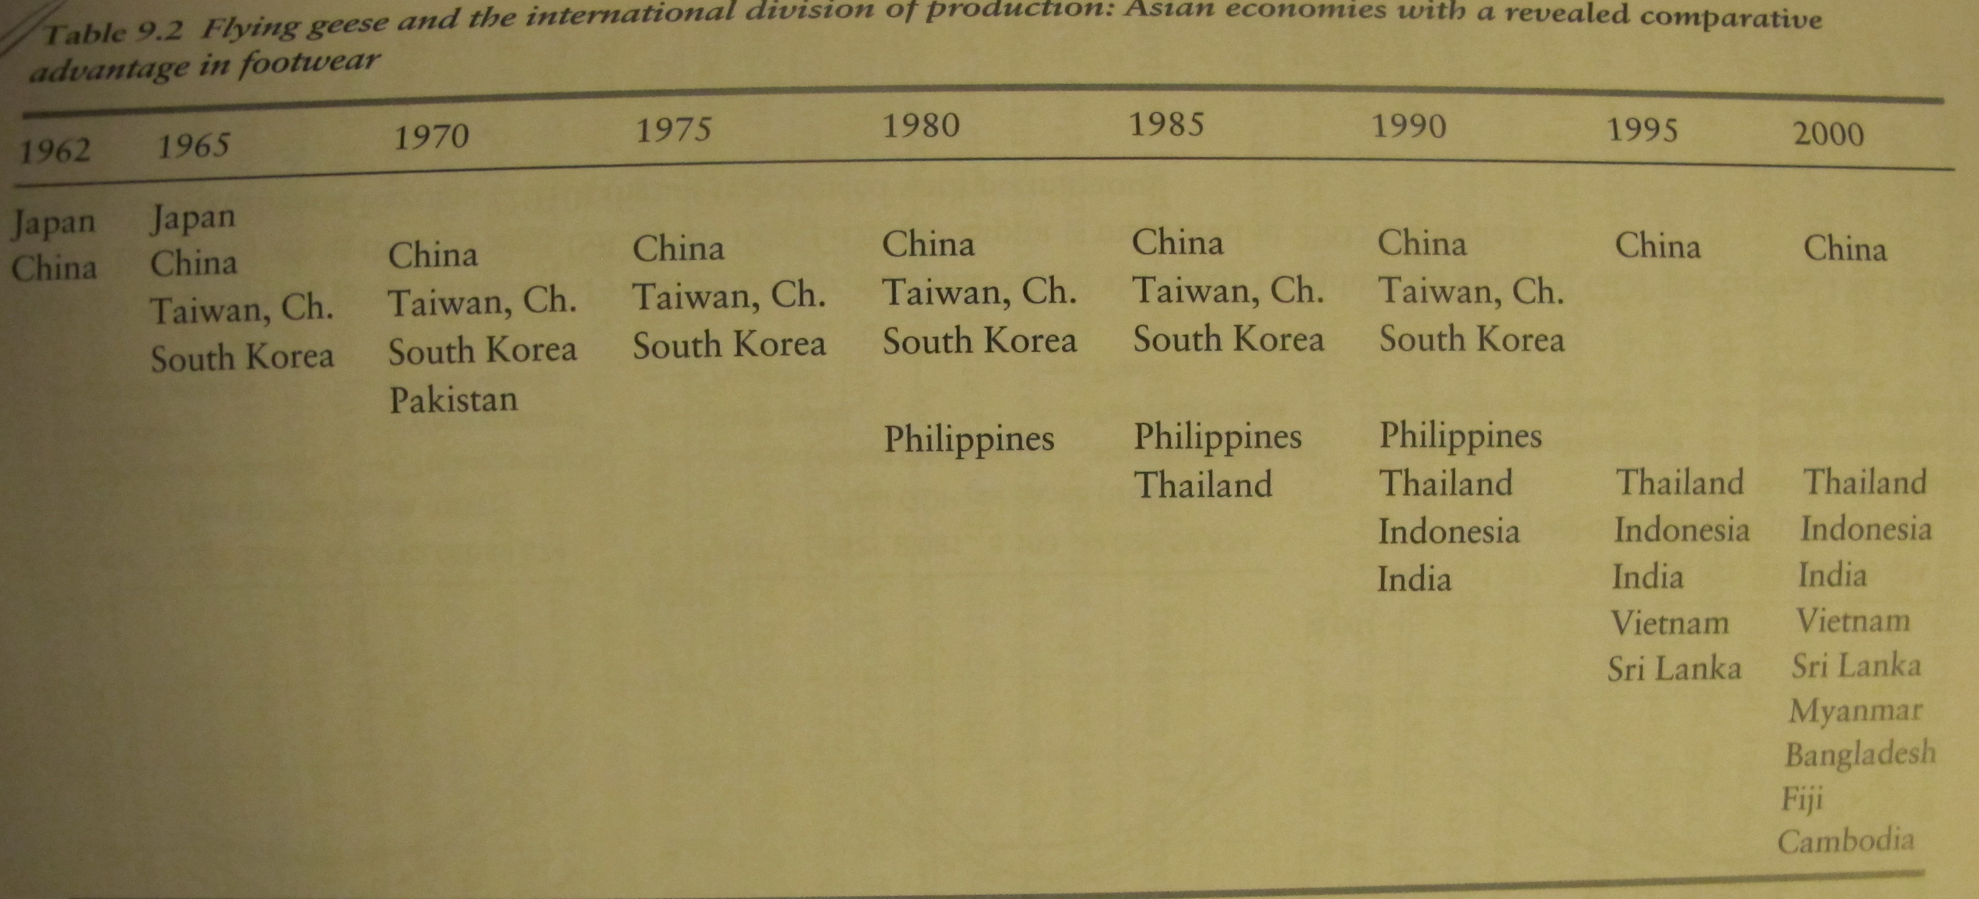

Slide 11
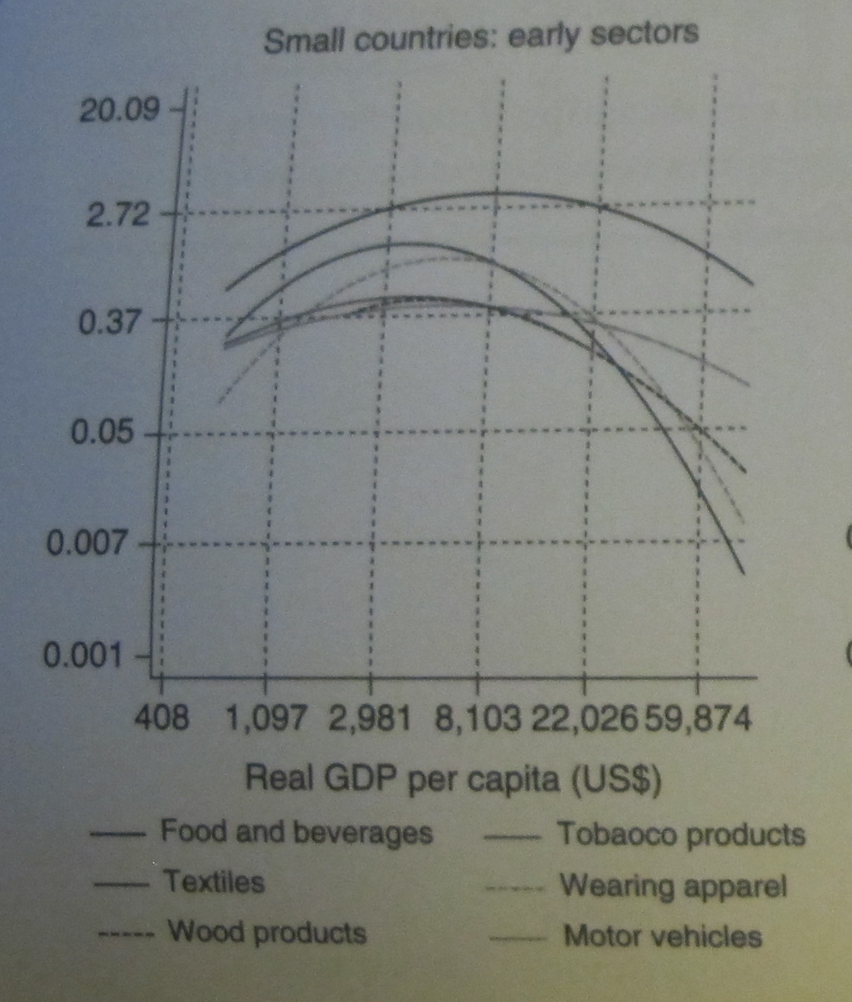

Slide 12
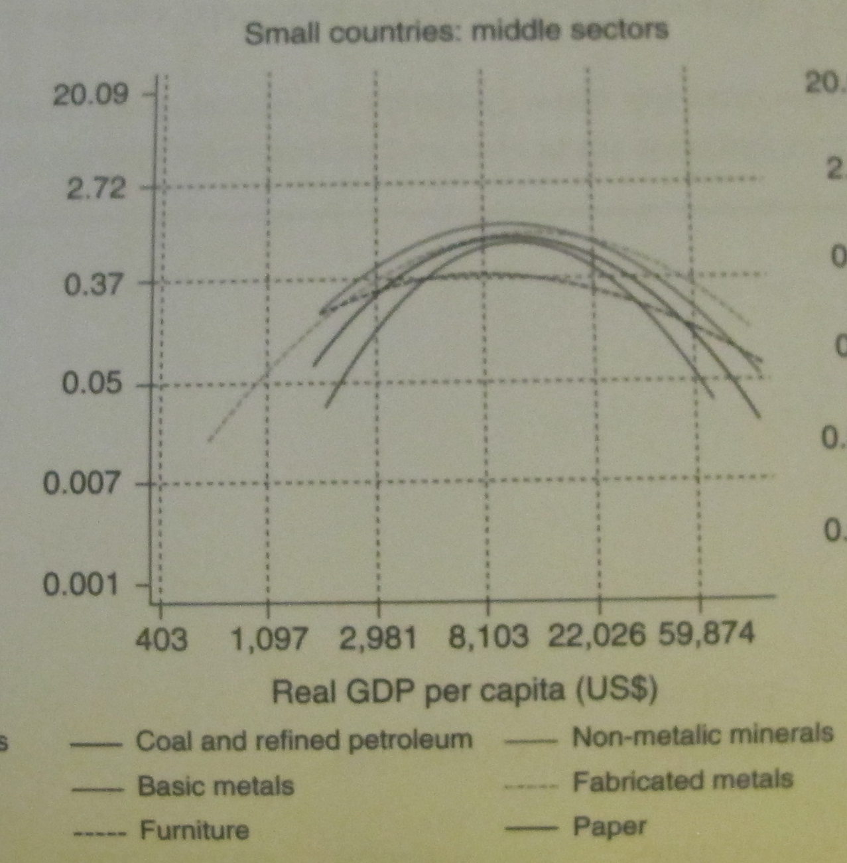

Slide 13
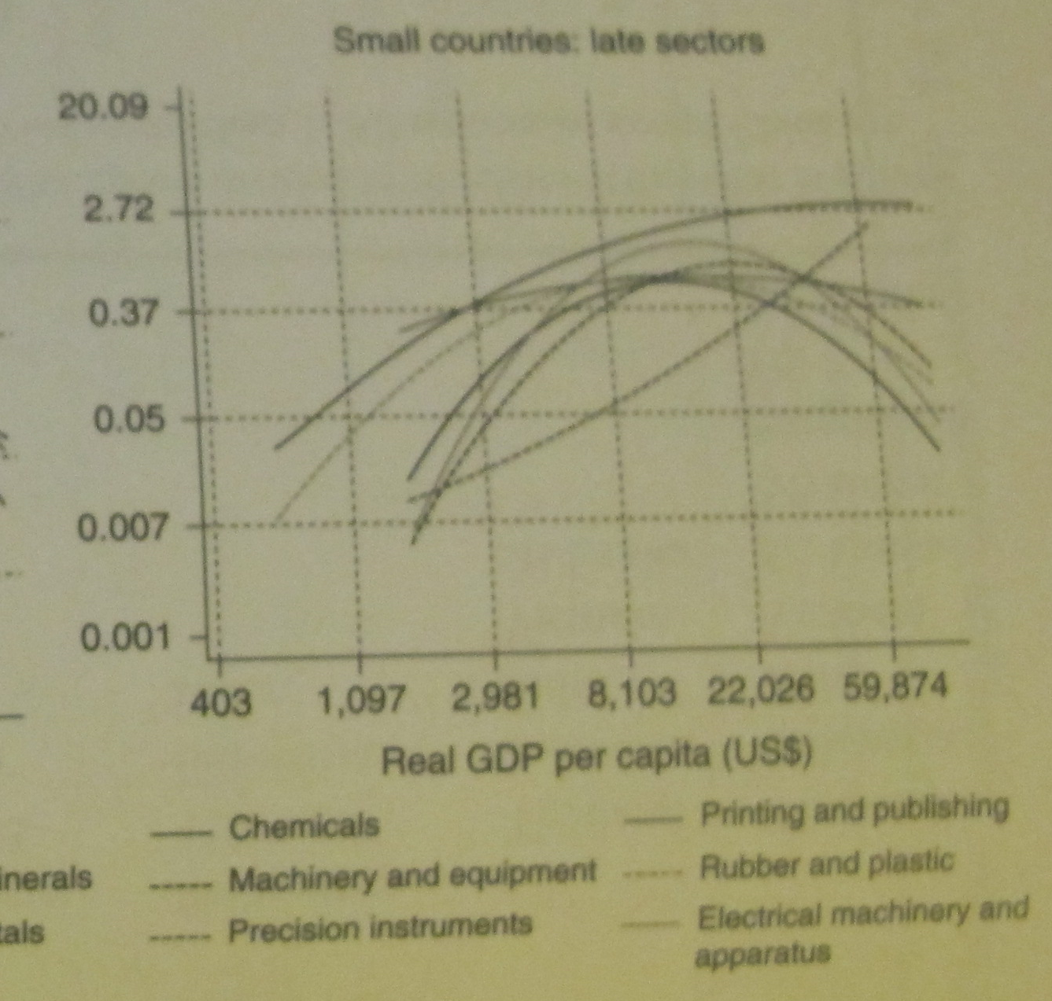

Slide 14
How to upgrade “Structure”? Some history
Import Substitution Strategy (China in 1950s and South American Countries even earlier): comparative-advantage-defying. High costs make the industry not competitive in the open economy.
Washington Consensus (free market approach): ignore market failure (results are controversial)

Slide 15
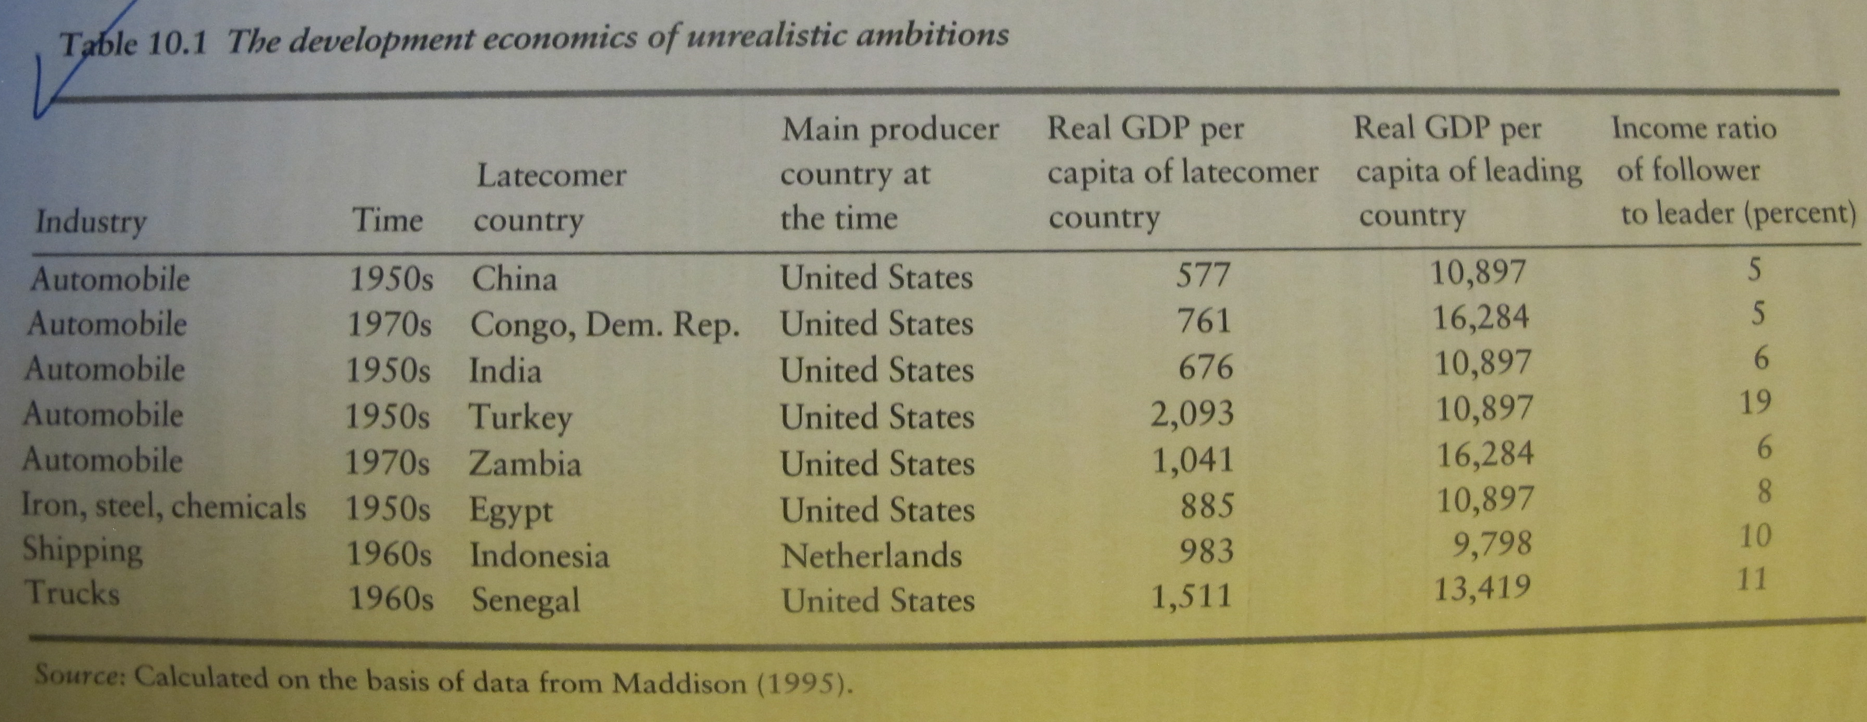
Examples of import substitution strategy

Slide 16
Market or Government?
The underlying logic of past view is “the private sector is better at identifying new industry”.
“First-mover problem” in developing countries
Government’s role of disseminating information, building market, selecting the prioritized industry, and giving incentives to first comers.

Slide 17
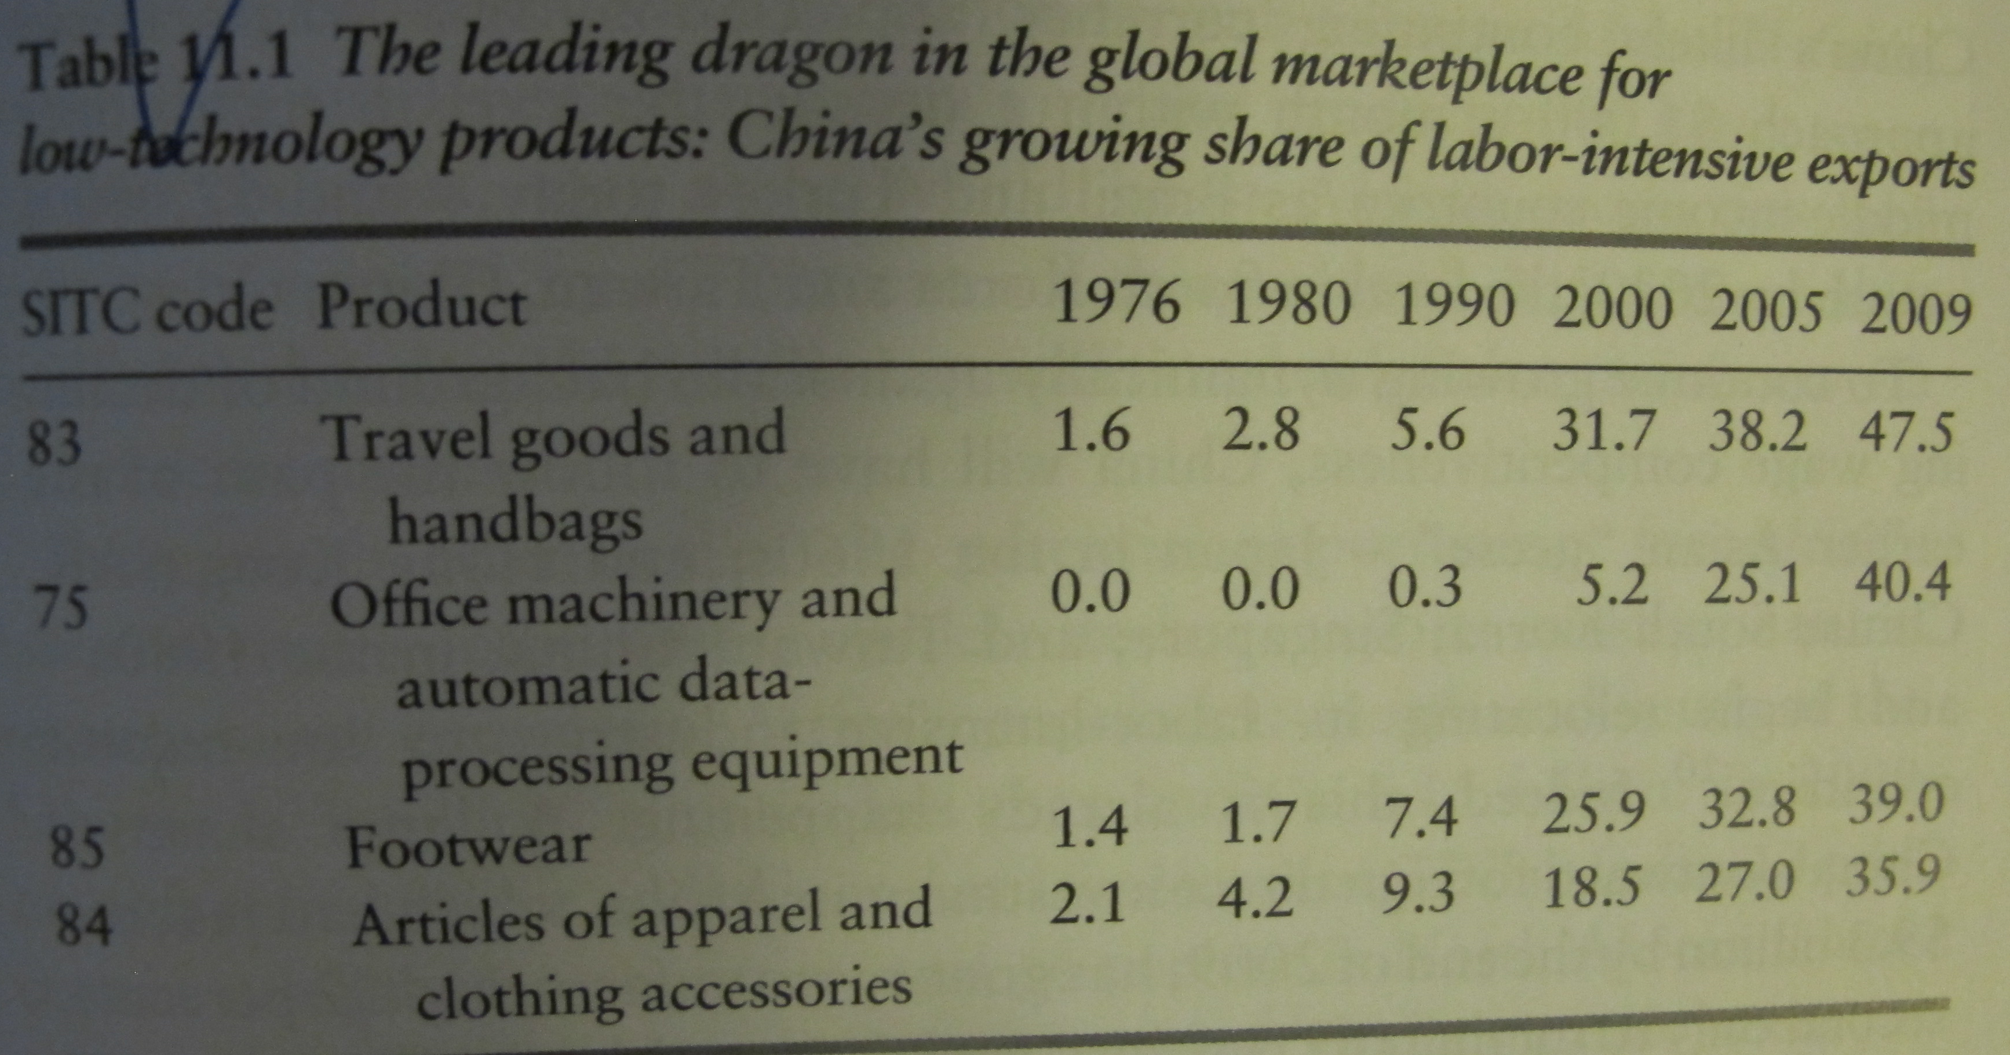
From flying geese to leading dragon

Slide 18
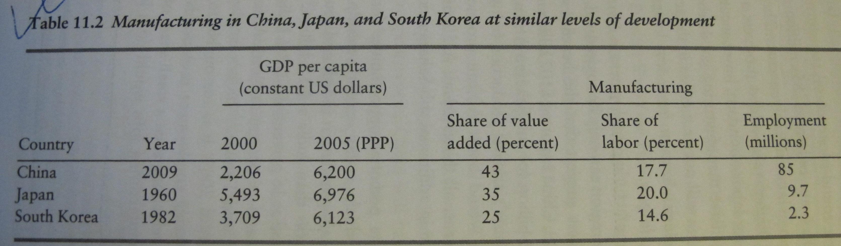
Leading dragon

Slide 19
End
Q &A

